Slide 1
Geolocation with MongoDB

Slide 2
What Geolocation (Geospatial queries) gives us?
Find places near location
Find places within certain area
Find places within certain distance

Slide 3
How MongoDB makes it possible?
It can store location data
It can search through this location data

Slide 4
Location data
Stored in GeoJSON format
{
_id: ObjectId(…),
…
…
“geometry”: {
“type”: "Point",
“coordinates”: [-73.856077, 40.848447]
}
…
}
Field, storing GeoJSON data
GeoJSON type
Coordinates (depending on type)

Slide 5
GeoJSON - Types
Point
LineString
Polygon
and others…

Slide 6
GeoJSON Type - Point
Usually represents Places
“geometry”: {
“type”: "Point",
“coordinates”: [-73.856077, 40.848447]
}

Slide 7
GeoJSON Type - LineString
Used to represent Streets, Rivers, Trails, etc…
“geometry”: {
“type”: “LineString",
“coordinates”: [
[23.315, 42.694],
[23.330, 42.710],
[23.330, 42.710],
[23.330, 42.710]
]
}

Slide 8
GeoJSON Type - Polygon
Used to represent Neighbourhoods, Cities, Buildings, etc…
“geometry”: {
“type”: “Polygon",
“coordinates”: [[
[23.3180, 42.6960],
[23.3240, 42.6960],
[23.3240, 42.7020],
[23.3180, 42.7020],
[23.3180, 42.6960] ]]
}

Slide 9
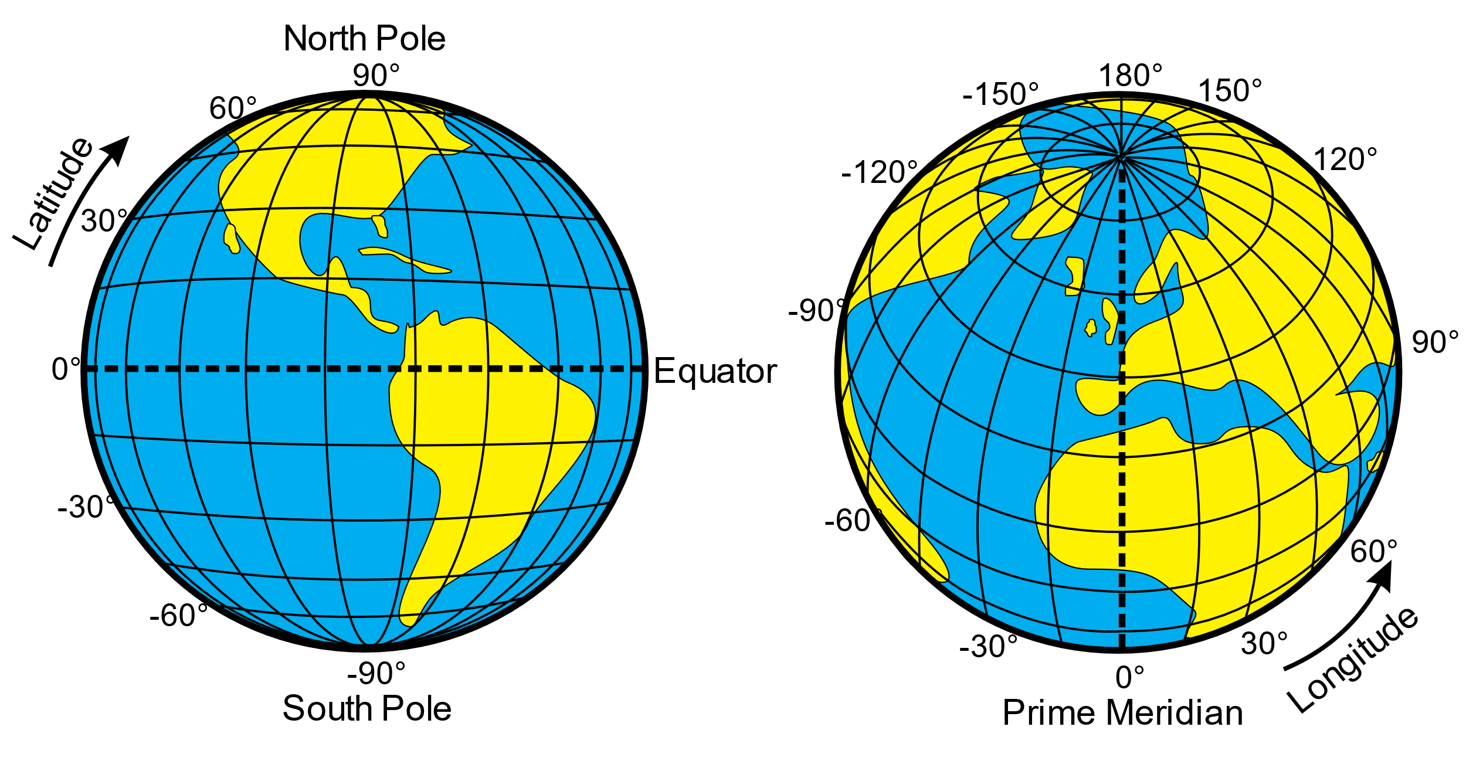
GeoJSON – Coordinates format
[longitude, latitude]
Sofia is around ~ [23.3199, 42.6983]
In Google Maps, they are the opposite order

Slide 10
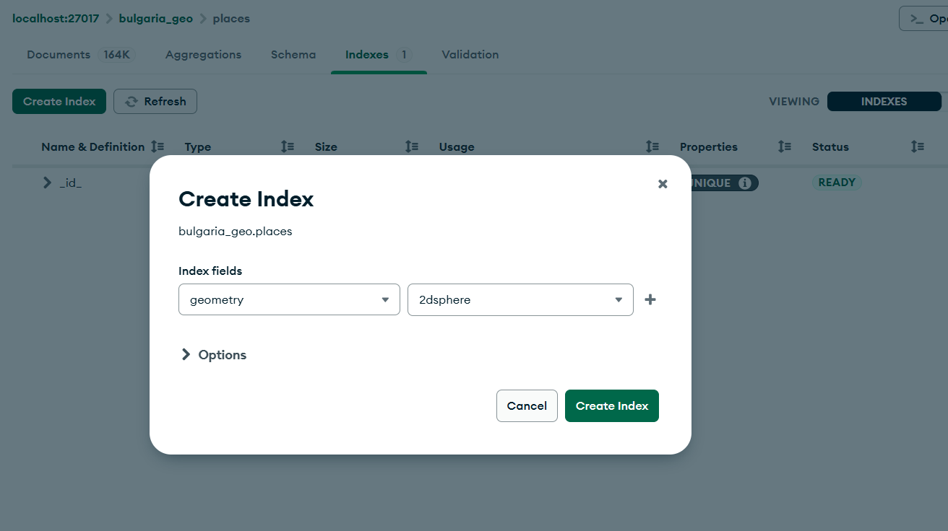
Index – 2dsphere

Slide 11
Let’s go with the sample Queries!

Slide 12
Find places near a Point ($near)
Usage: To find places within certain Radius from specified Point, in sorted Distance order, nearest first.
{
<location field>: {
$near: {
$geometry: {
type: "Point" ,
coordinates: [ <longitude> , <latitude> ]
},
$maxDistance: <distance in meters>,
$minDistance: <distance in meters>
}
}
}
{
"geometry": {
"$near": {
"$geometry": {
"type": "Point",
"coordinates": [23.3199, 42.6983]
},
"$maxDistance": 500
}
}
}

Slide 13
Filtering places by Distance within a circle by using $geoWithin
Usage: Find places within certain Radius from specified Center Point (i.e. circle query), WITHOUT sorting by Distance.
Benefit: Faster query compared to $near
{
<location field>: {
$geoWithin: { <shape operator>: <coordinates> }
}
}
{
"geometry": {
"$geoWithin": {
"$centerSphere": [ [23.3199, 42.6983], 2/6378.1 ]
}
}
}
Shape operator

Slide 14
Quick Detour: $centerSphere operator

Slide 15
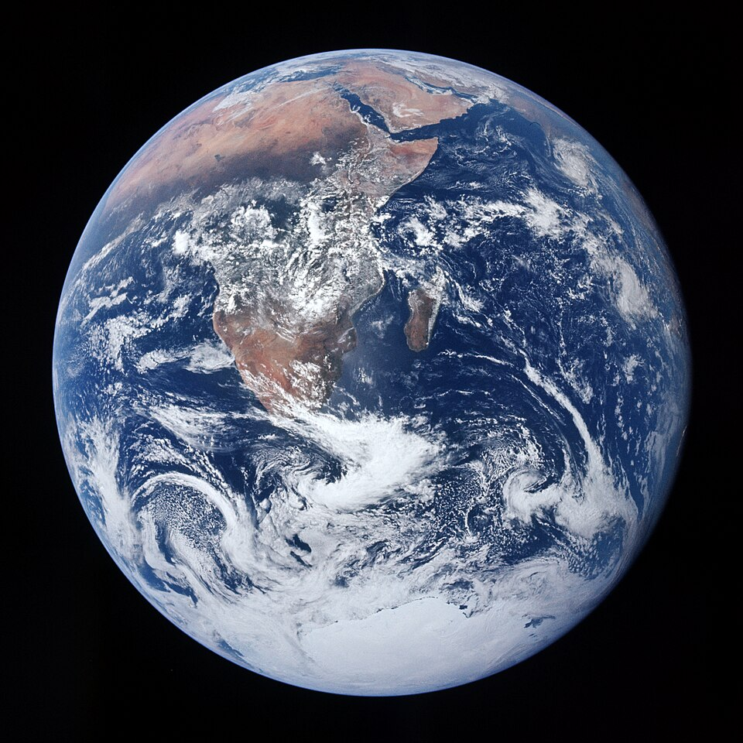
$centerShpere operator
Radius of the circle in Radians
"$centerSphere": [ [23.3199, 42.6983], 2/6378.1 ]
Center of the circle
Radius in km
Radius of the Earth

Slide 16
$centerShpere = circle on a sphere

Slide 17
Filtering places by Distance within a circle by using $geoWithin
Usage: we may not need places to be sorted, but only found places within certain Radius (circle query).
Benefit: Faster query compared to $near
{
<location field>: {
$geoWithin: { <shape operator>: <coordinates> }
}
}
{
"geometry": {
"$geoWithin": {
"$centerSphere": [ [23.3199, 42.6983], 2/6378.1 ]
}
}
}
Shape operator

Slide 18
Filtering places within a irregular shape (Polygon) by using $geoWithin
{
<location field>: {
$geoWithin: {
$geometry: {
type: <"Polygon" or "MultiPolygon"> ,
coordinates: [ <coordinates> ]
}
}
}
}
{
“geometry”: {
$geoWithin: {
$geometry: {
type: "Polygon",
coordinates: [[
[23.3180, 42.6960],
[23.3240, 42.6960],
[23.3240, 42.7020],
[23.3180, 42.7020],
[23.3180, 42.6960]
]]
}
}
}
}

Slide 19
Finding places which Intersect with other Places ($geoIntersects)
Usage: to find Places, whose Shapes/Locations overlap partially or fully
{
<location field>: {
$geoIntersects: {
$geometry: {
type: "<GeoJSON object type>" ,
coordinates: [ <coordinates> ]
}
}
}
}
{
“geometry”: {
$geoIntersect: {
$geometry: {
type: "Polygon",
coordinates: [[
[23.3180, 42.6960],
[23.3240, 42.6960],
[23.3240, 42.7020],
[23.3180, 42.7020],
[23.3180, 42.6960]
]]
}
}
}
}

Slide 20
$geoIntersects vs $geoWithin

Slide 21
Disclaimer: 2dsphere Index vs 2d Index
GeoJSON is supported ONLY by 2dsphpere Index
Legacy coordinates (2d) is supported 2d Index. Only points from 2d are supported in 2dsphere.

Slide 22
Let’s do the Lab!

